Slide 1
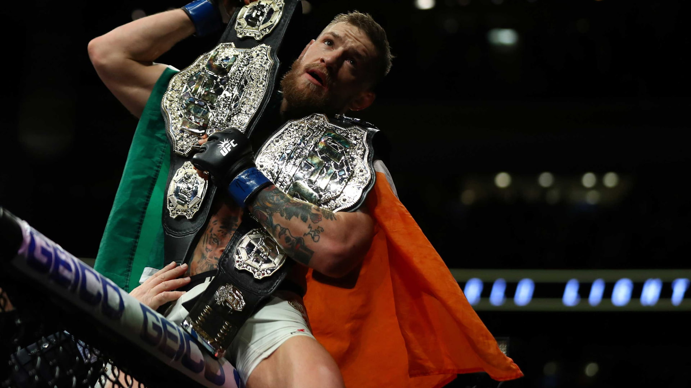

Optimize UFC fight for betting
Created by Caaron

Slide 2
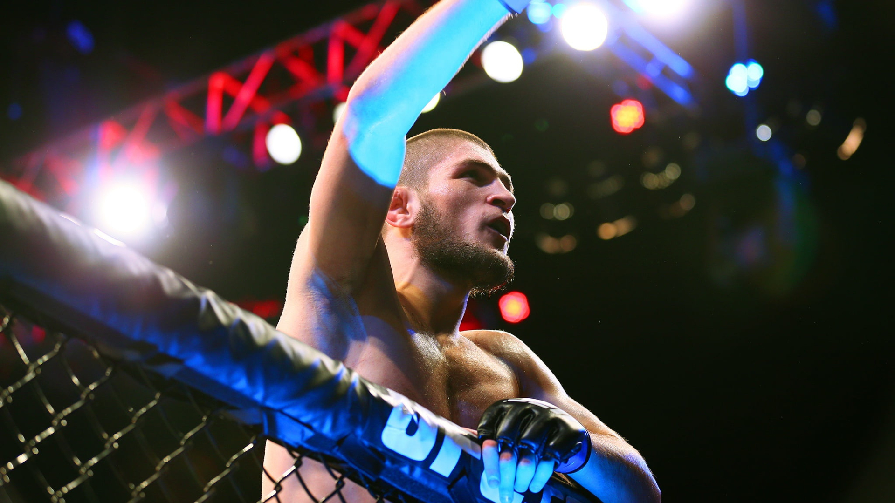
Table of Content
1
List of tools / technologies used in this project
NumPy
Pandas
Matplotlib
SkLearn
Streamlit
What is UFC ?
2
List of technologies used
3
Judges score scheme
4
Data cleaning
5
Graph analysis
6
Conclusion
7
Fight prediction

Slide 3
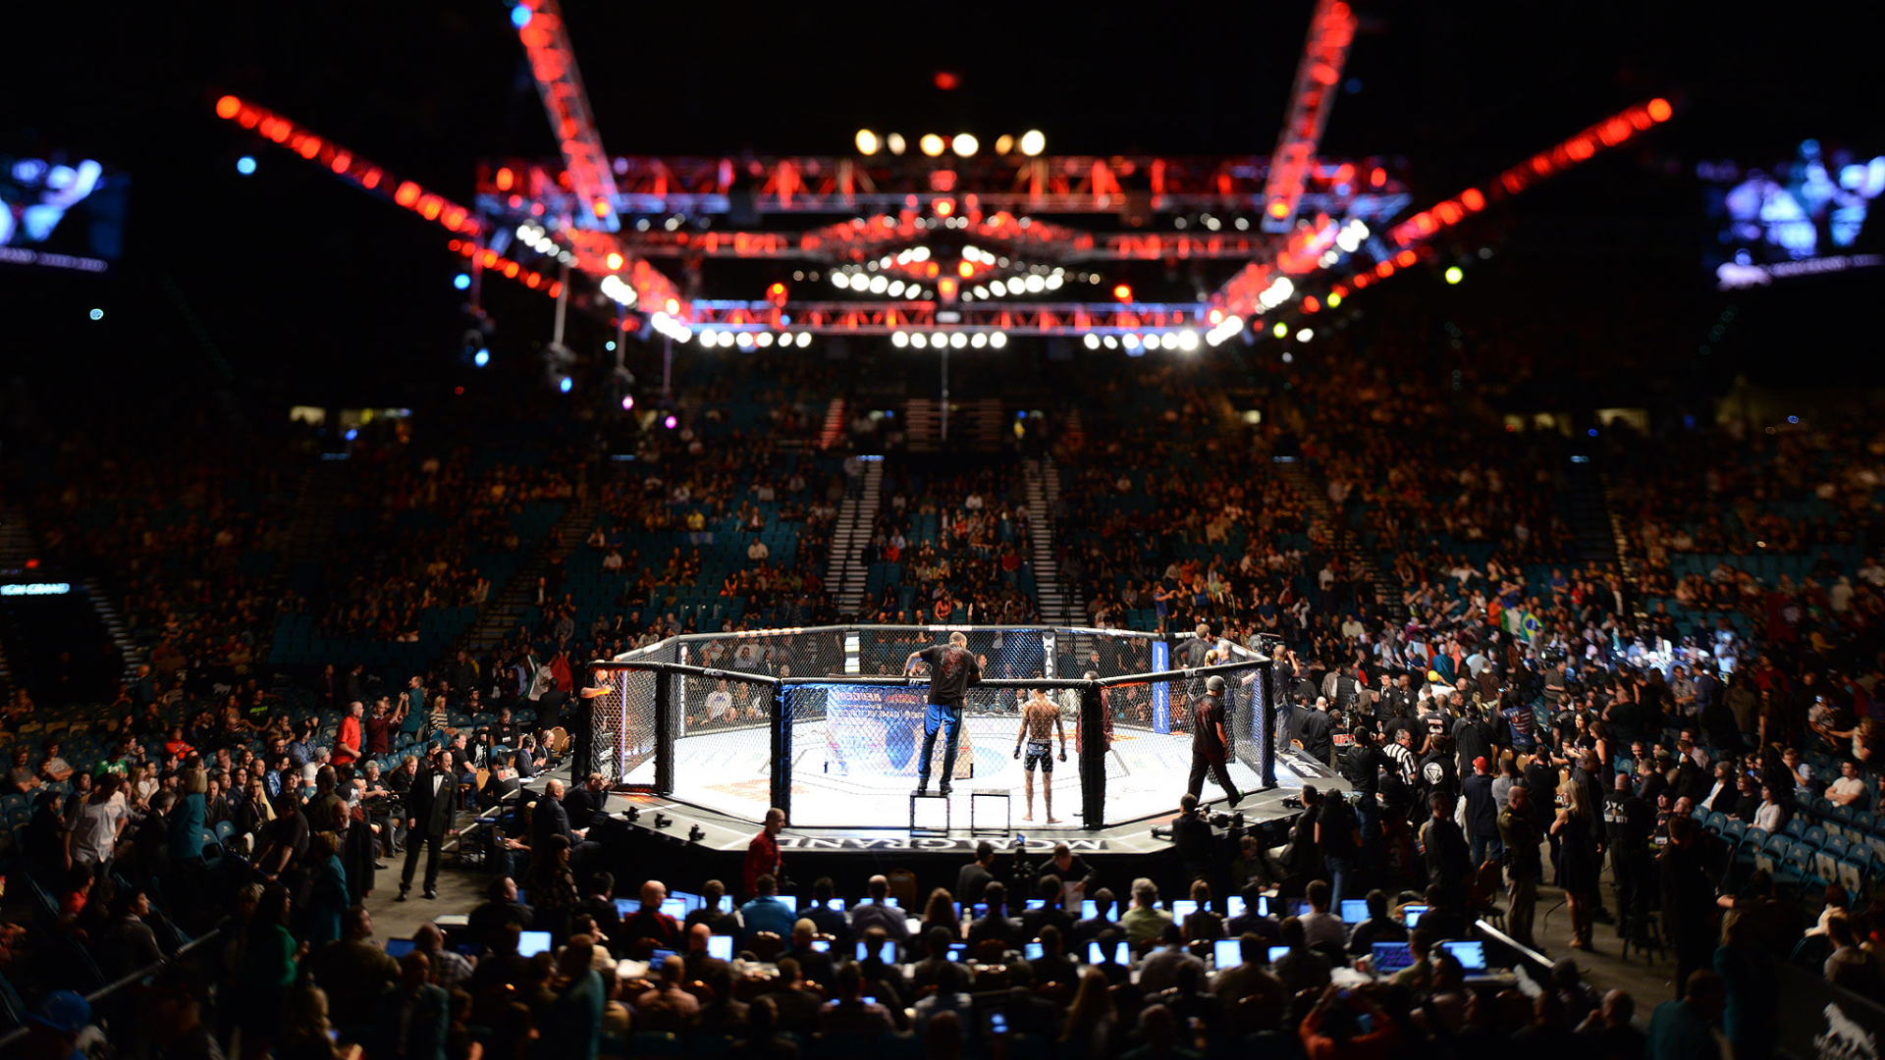
What is UFC ?
UFC stands for the Ultimate Fighting Championship. It is an American mixed martial arts (MMA) promotion company and the largest and most well-known MMA organization in the world.
The fights take place under a set of rules that allow various fighting techniques, including striking (punches, kicks, clinch, and elbows) and grappling (wrestling and submissions).

Slide 4
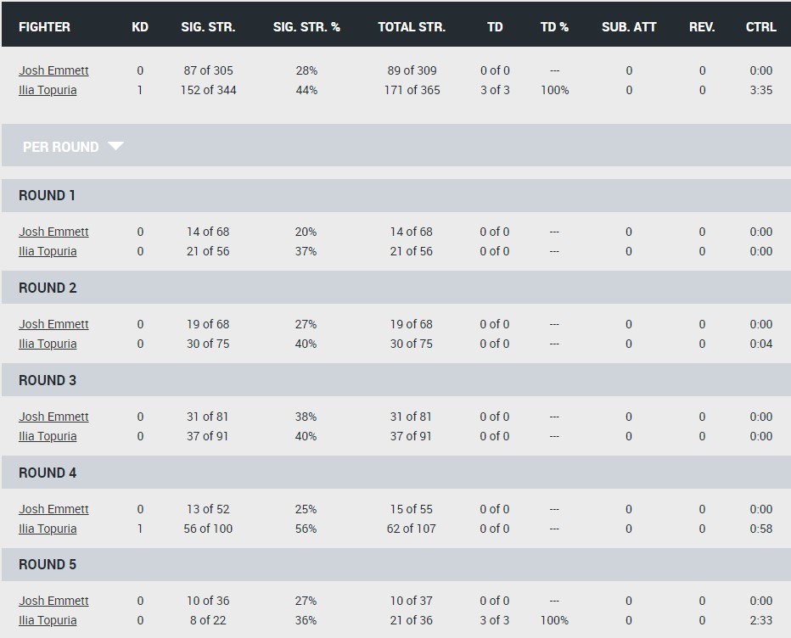
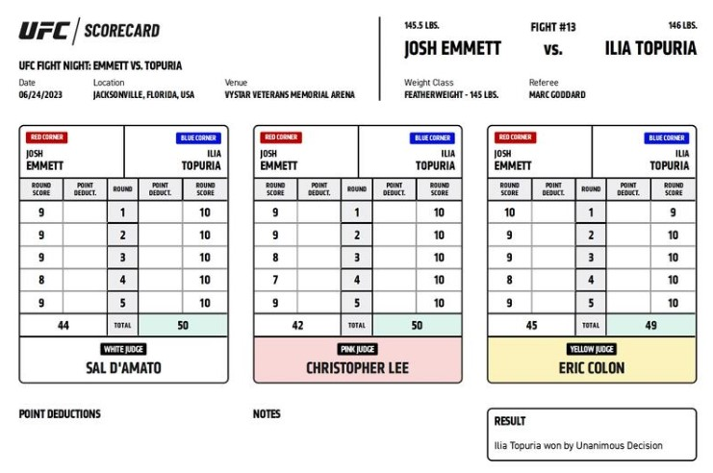
UFC judges score scheme

Slide 5
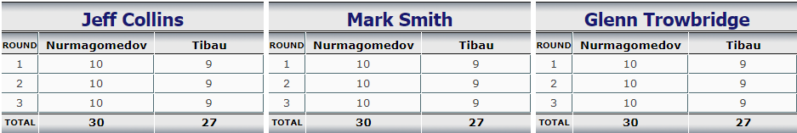
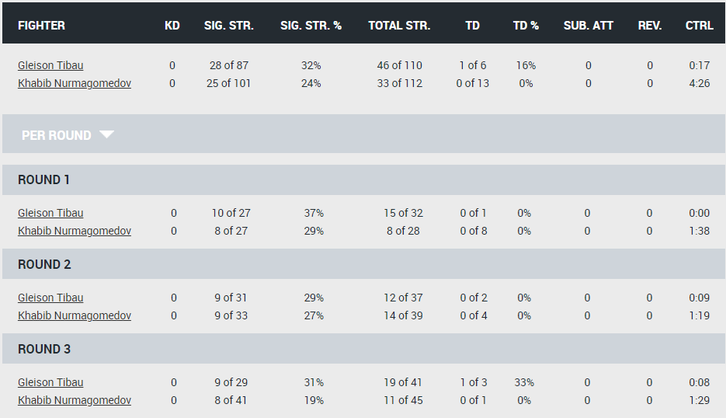
UFC judges score scheme

Slide 6
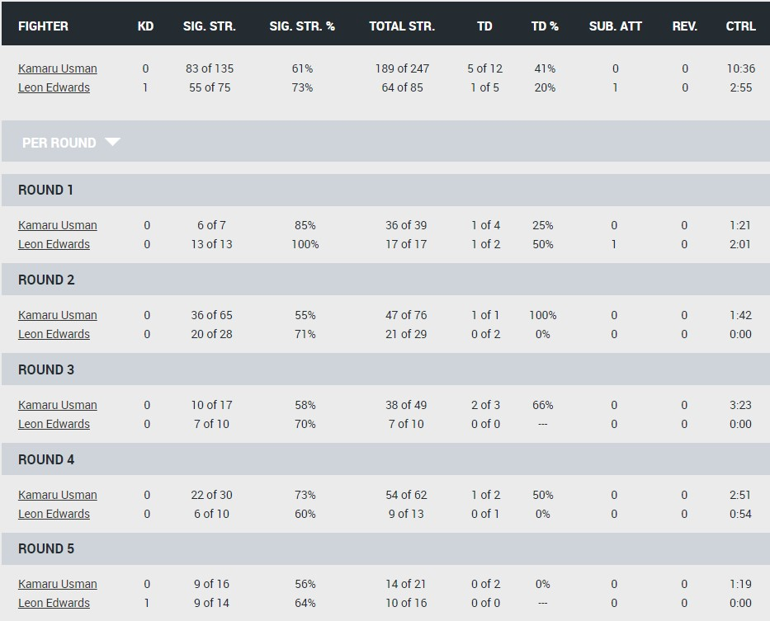
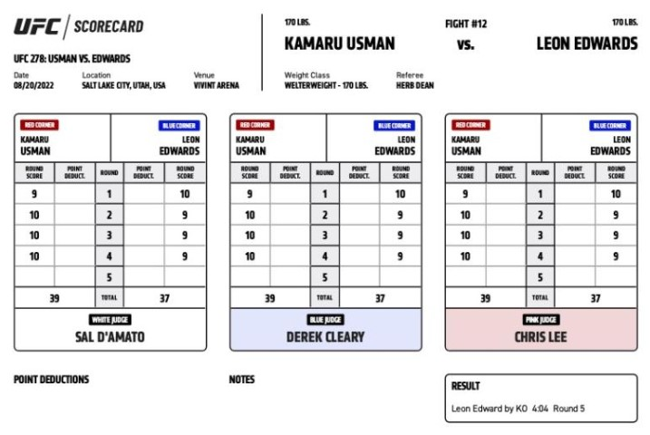
UFC judges score scheme

Slide 7
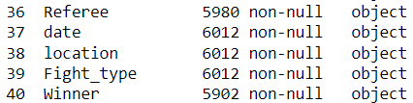
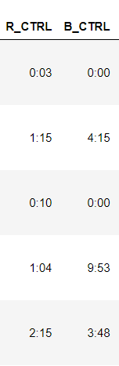
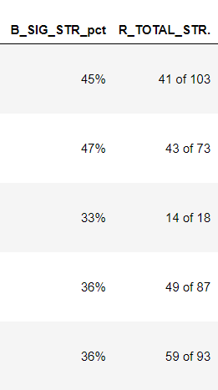
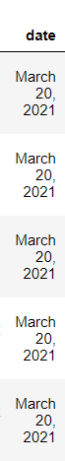
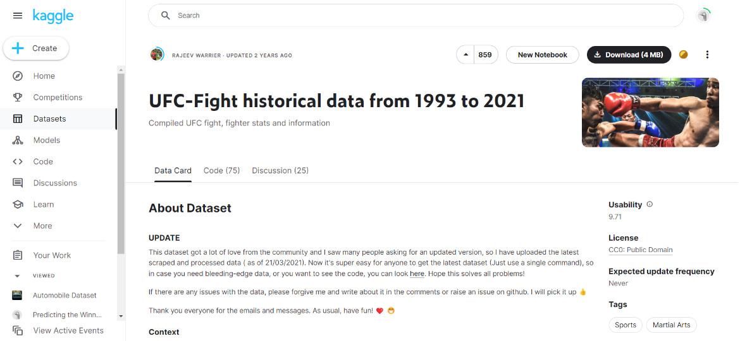
Data Cleaning
Data source : https://www.kaggle.com/datasets/rajeevw/ufcdata

Slide 8
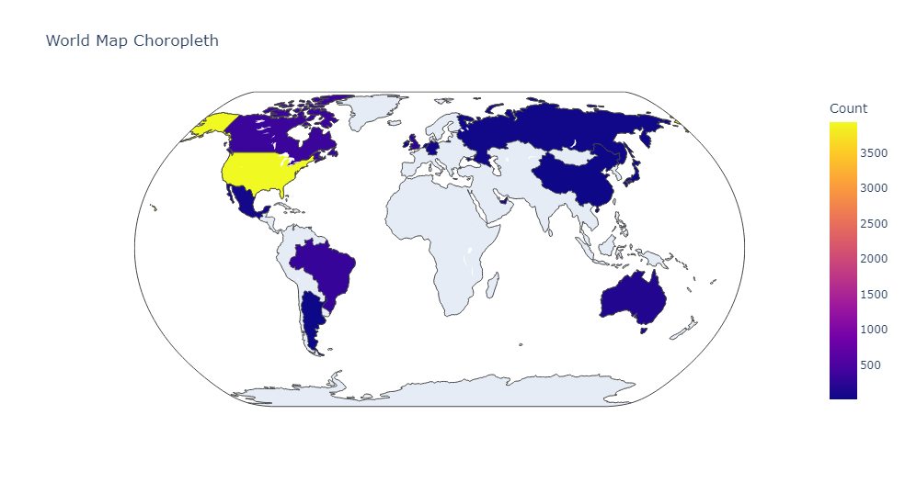
Countries of hosting UFC
Canada – 365
Brazil – 333
UK – 255
Australia – 173
Mexico - 72

Slide 9
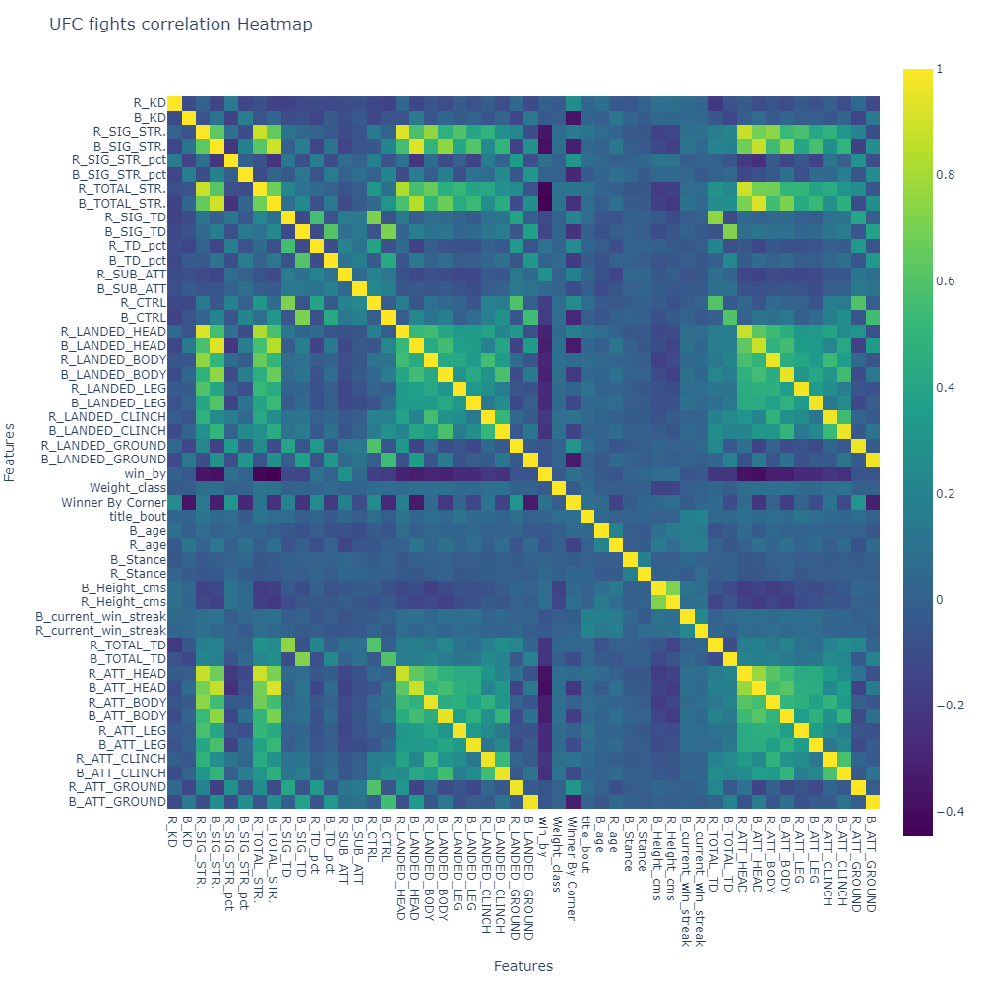
Correlation Heatmap
Related | Not Related
R (head, body, leg, clinch) Attempt B (head, body, leg, clinch) Landed | Win By B Total Str
R Distance B Head Attempt | Winner By Corner R Ground Attempt
R Total Strike R Head Attempt | Win By B Head Attempt
B Head Attempt B Sig strike
R Sig Strike R Total Strike

Slide 10
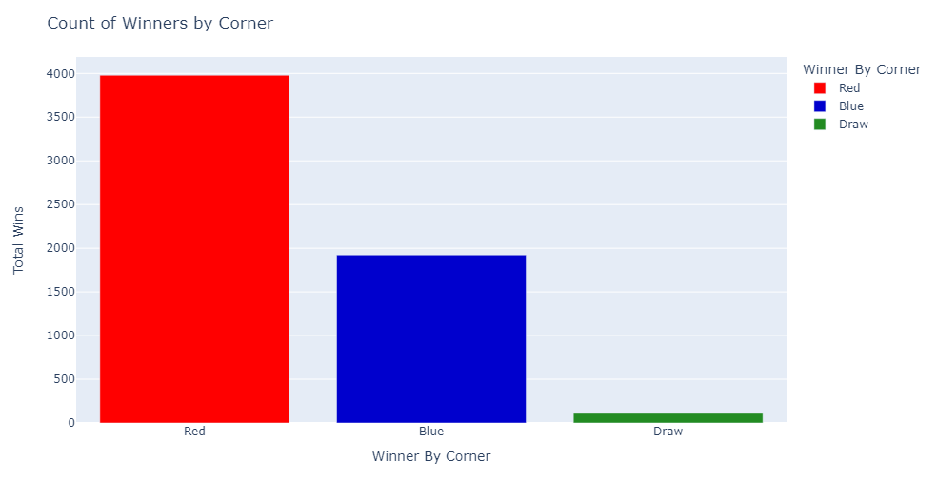
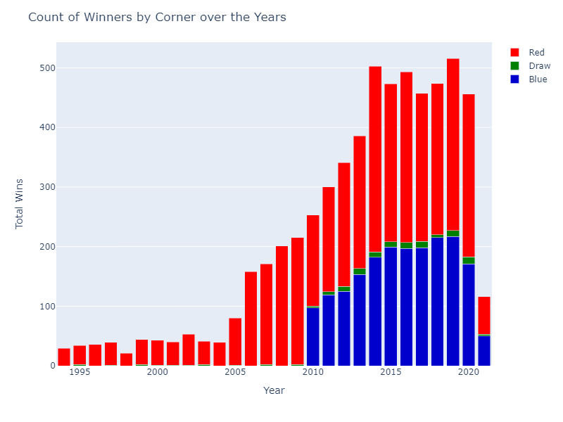
Winners by corner

Slide 11
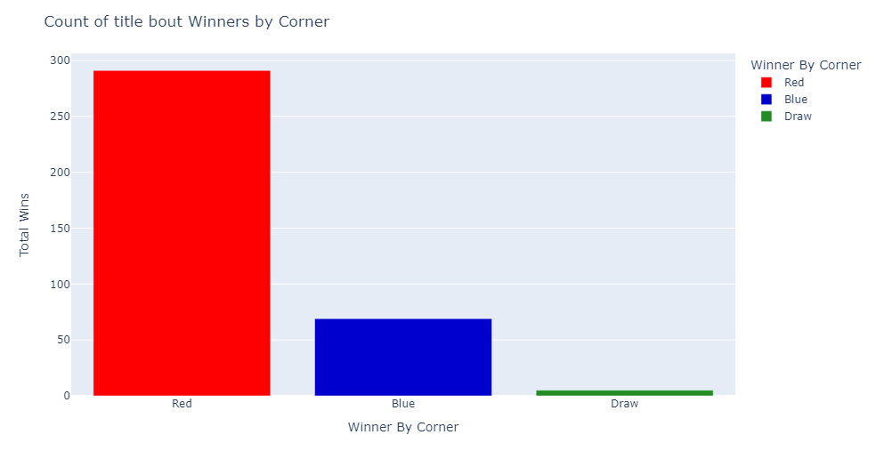
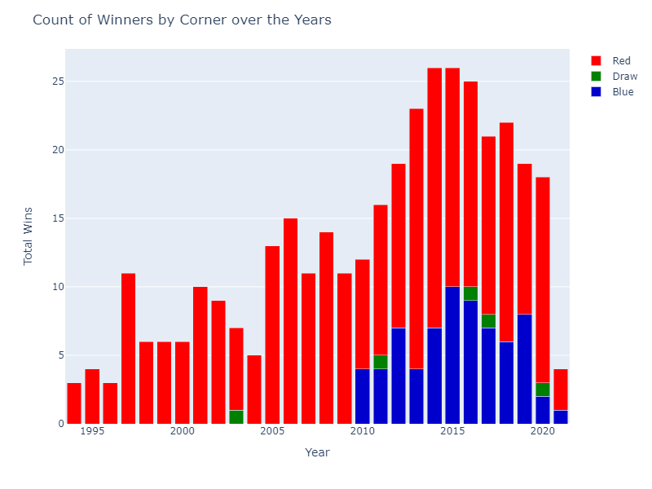
Title bout winners by corner

Slide 12
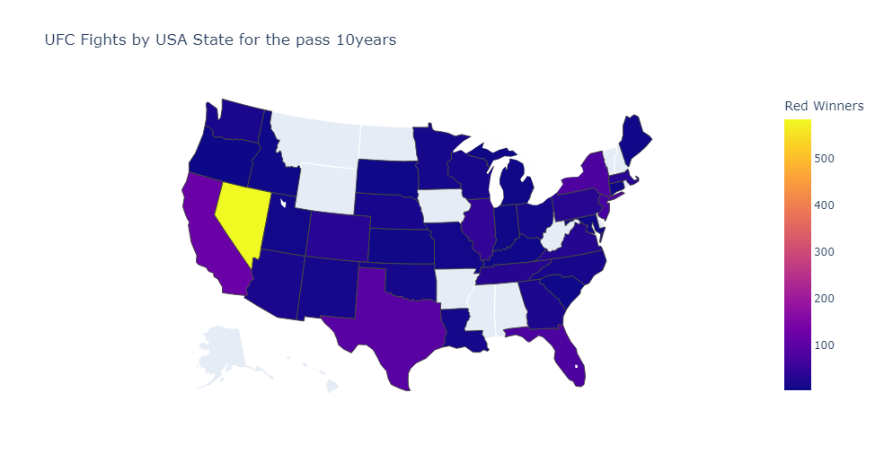
UFC fights by USA states
Nevada - Red 586 / Blue 411
California - Red 121 / Blue 92
Texas - Red 97 / Blue 78
New York - Red 80 / Blue 59
Florida - Red 79 / Blue 69

Slide 13
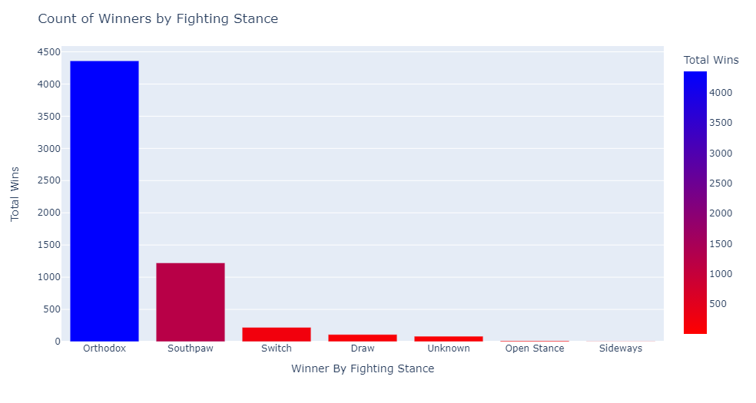
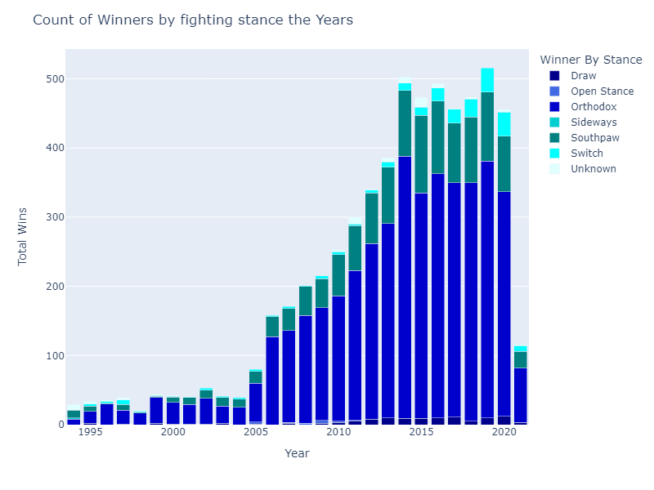
Winners by fighting stance

Slide 14
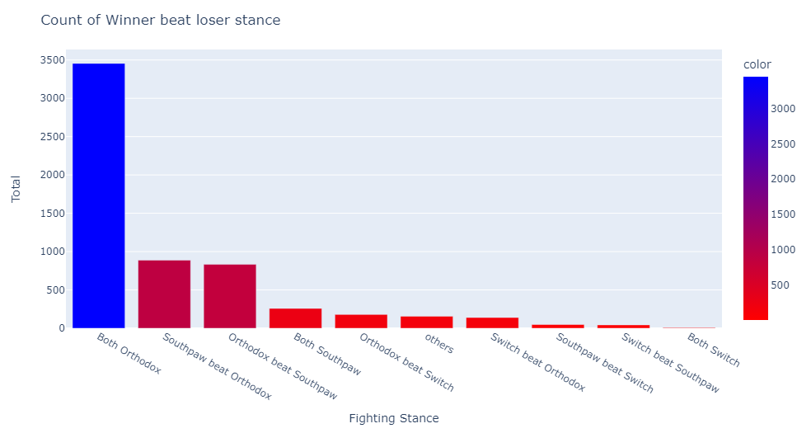
Winners by fighting stance

Slide 15
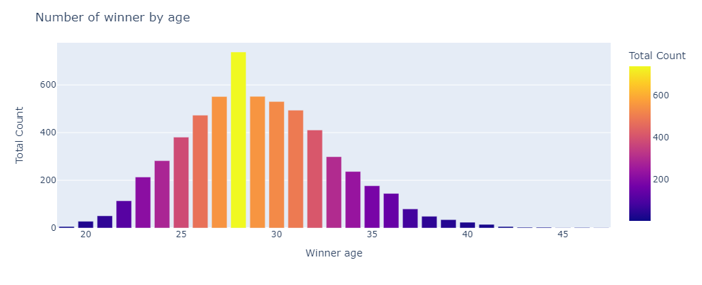
Winners by age

Slide 16
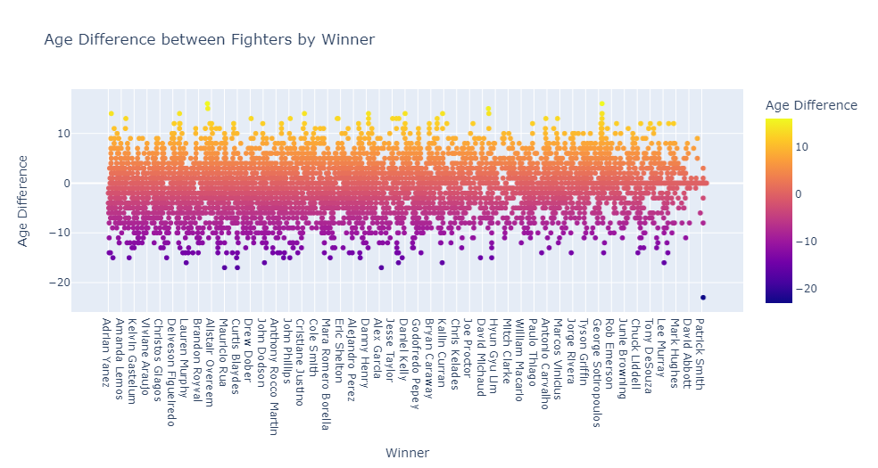
Winners age difference

Slide 17
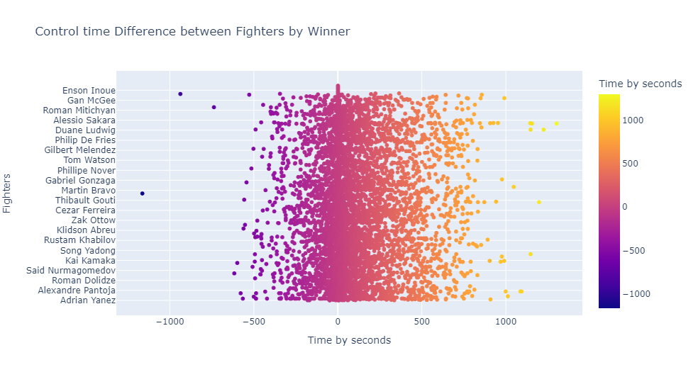
Winners control time difference

Slide 18
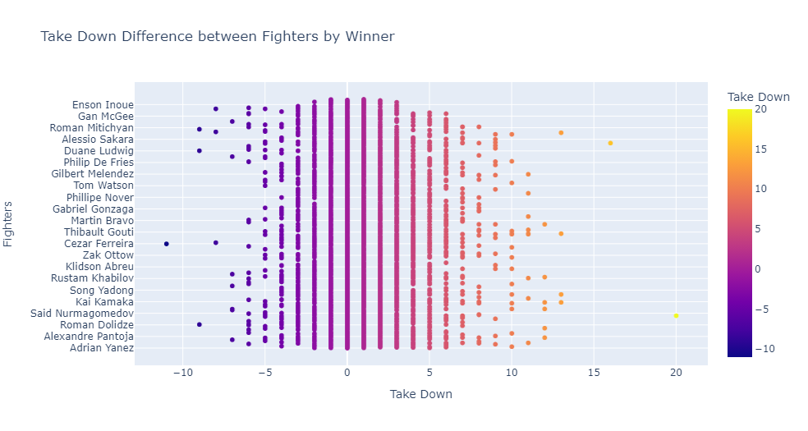
Winners take down times difference

Slide 19
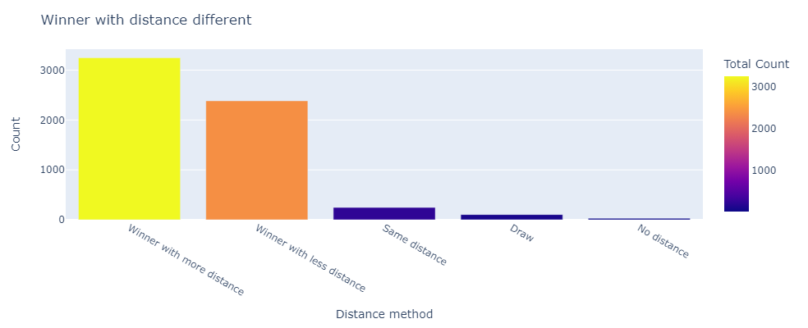
Winners with distance different

Slide 20
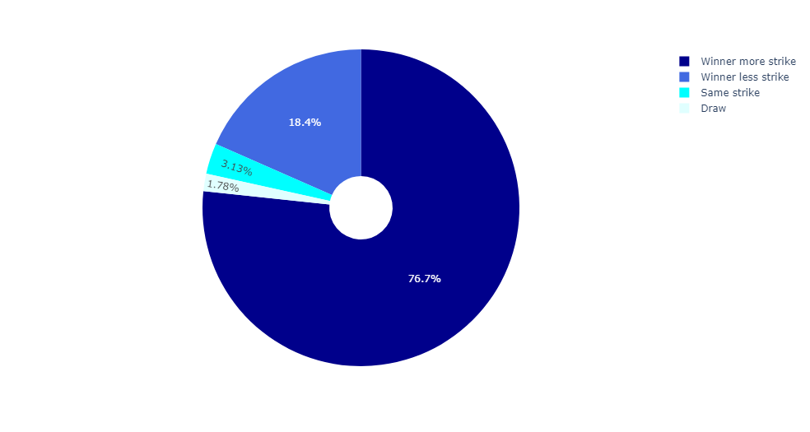
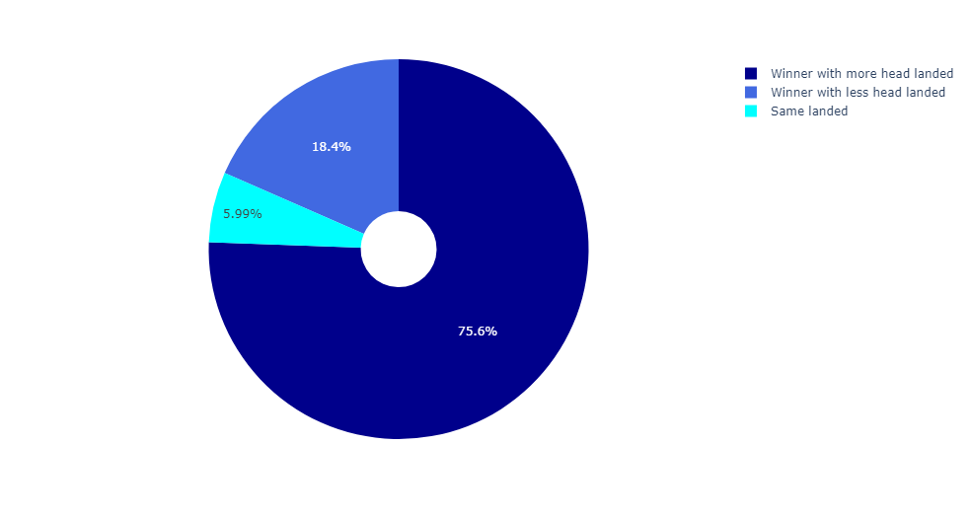
Striking and Head landed

Slide 21
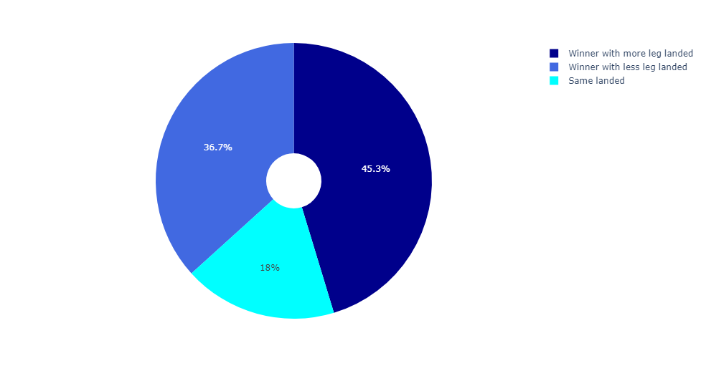
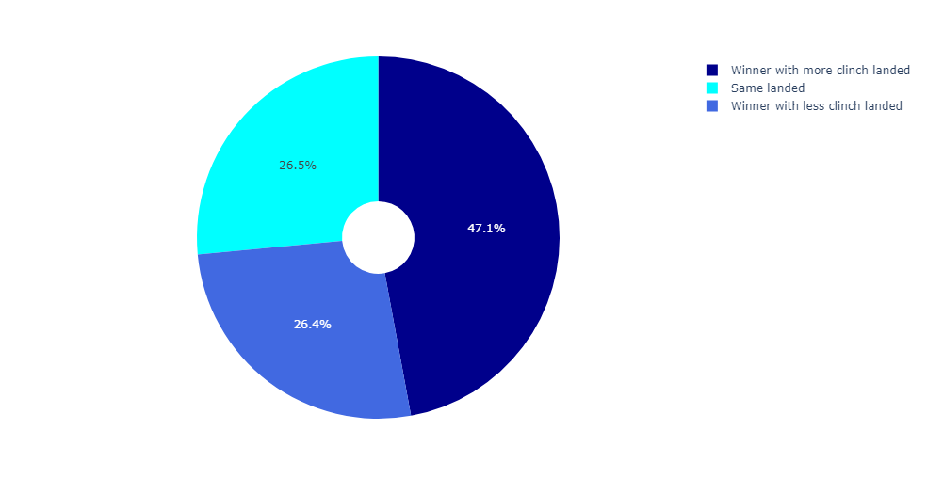
Leg landed and Clinch landed

Slide 22
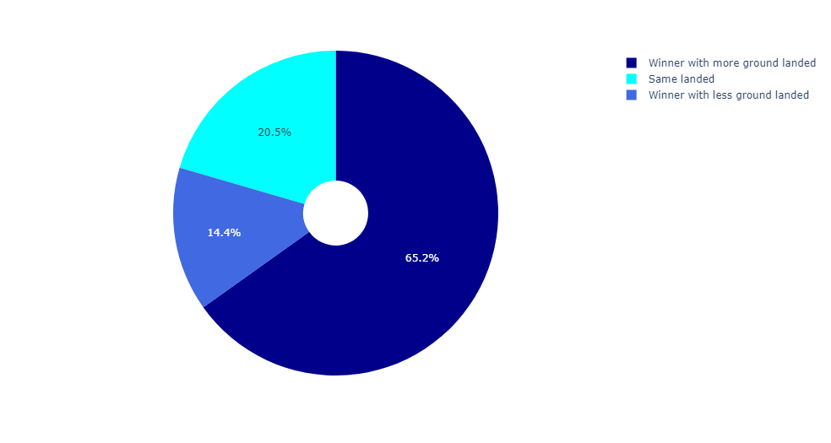
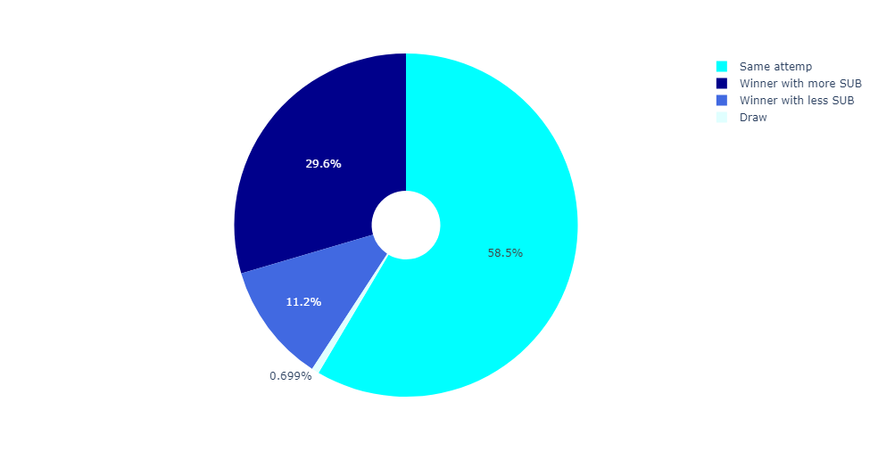
On ground landed and Submission

Slide 23
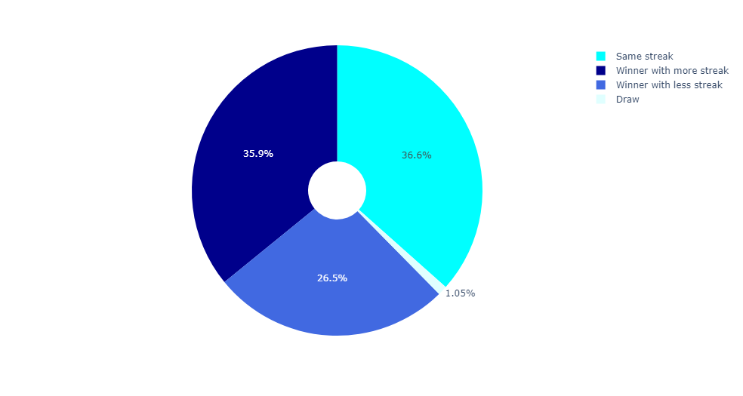
Winner with more current winning streak

Slide 24
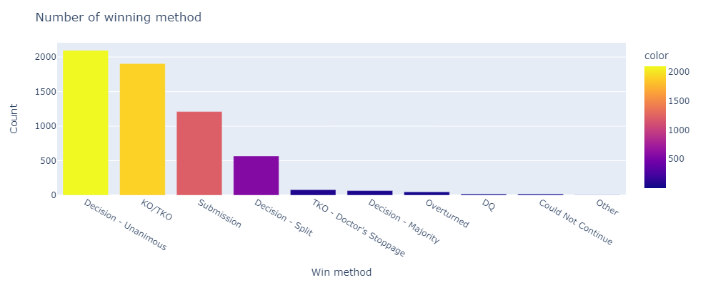
Winner by winning method

Slide 25
Conclusion
We can predict the fight base on the tactics from the graph with better outcome.
Important | Not Important
Striking Skills | Age
Control Times | Fighting Stance
Take Down | Wining Streak
Winning Method (KO/Submission) | Distance
Fighter Corner (Title Bout)

Slide 26
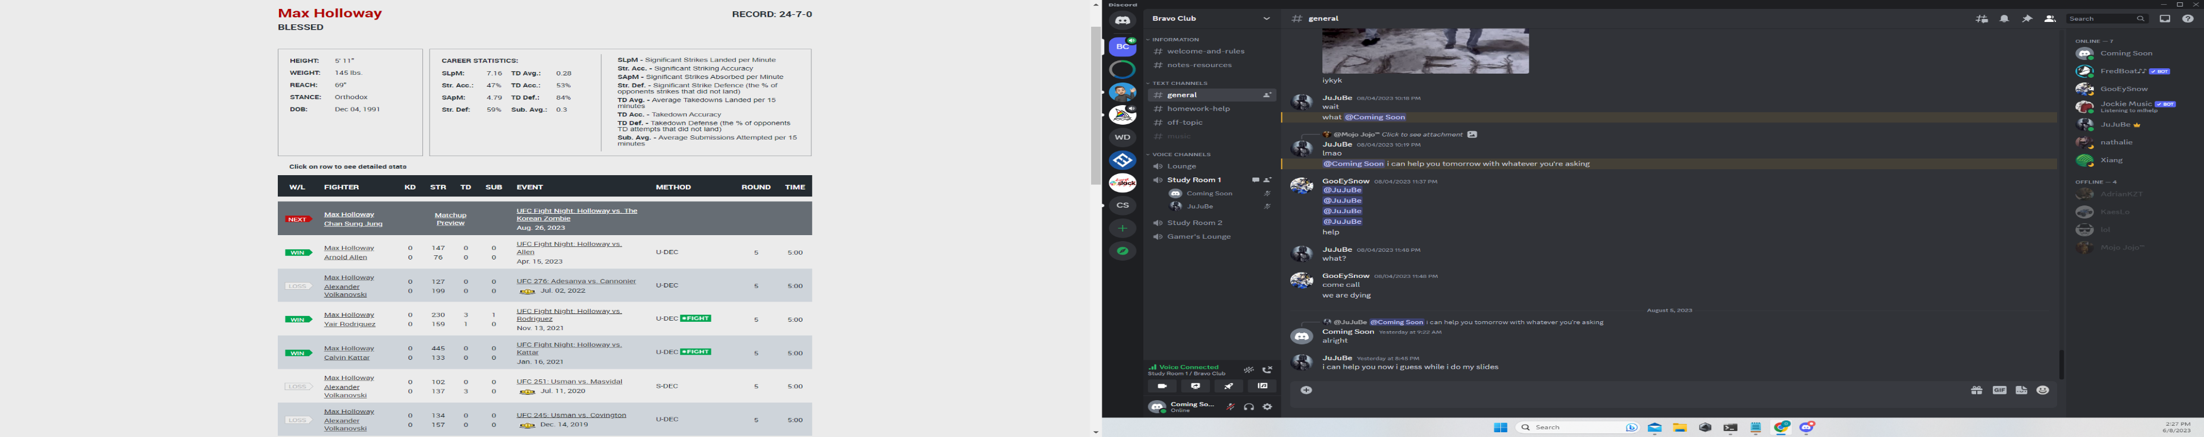
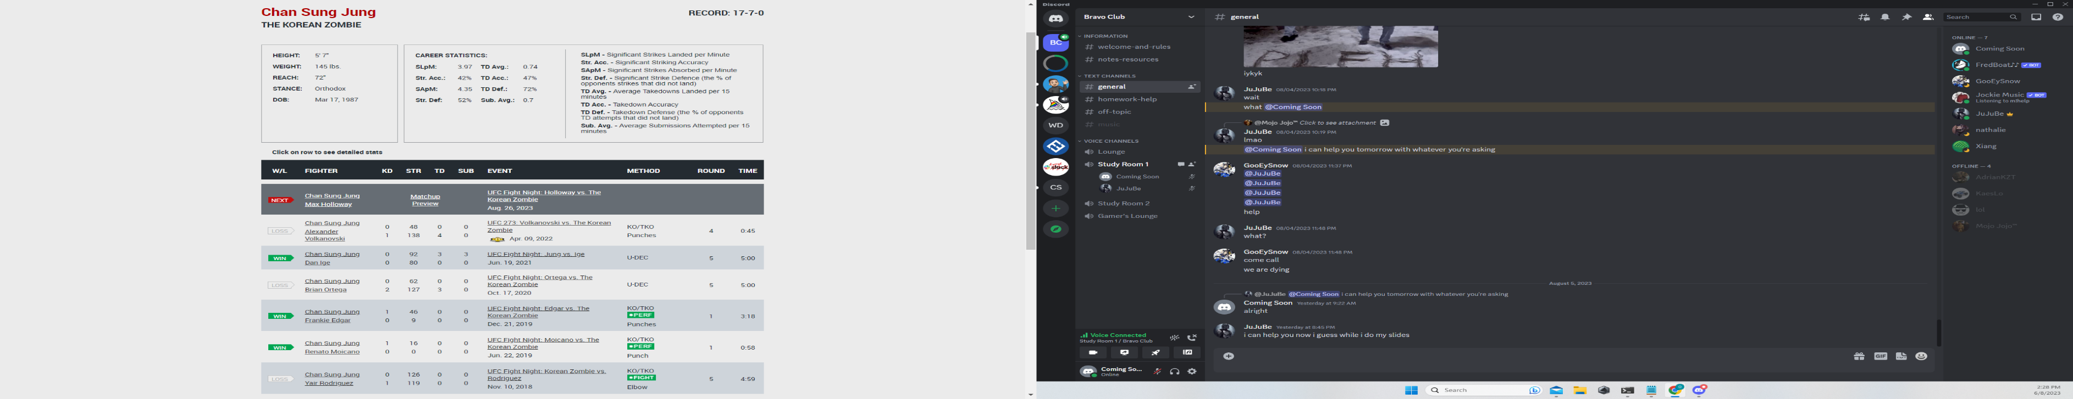
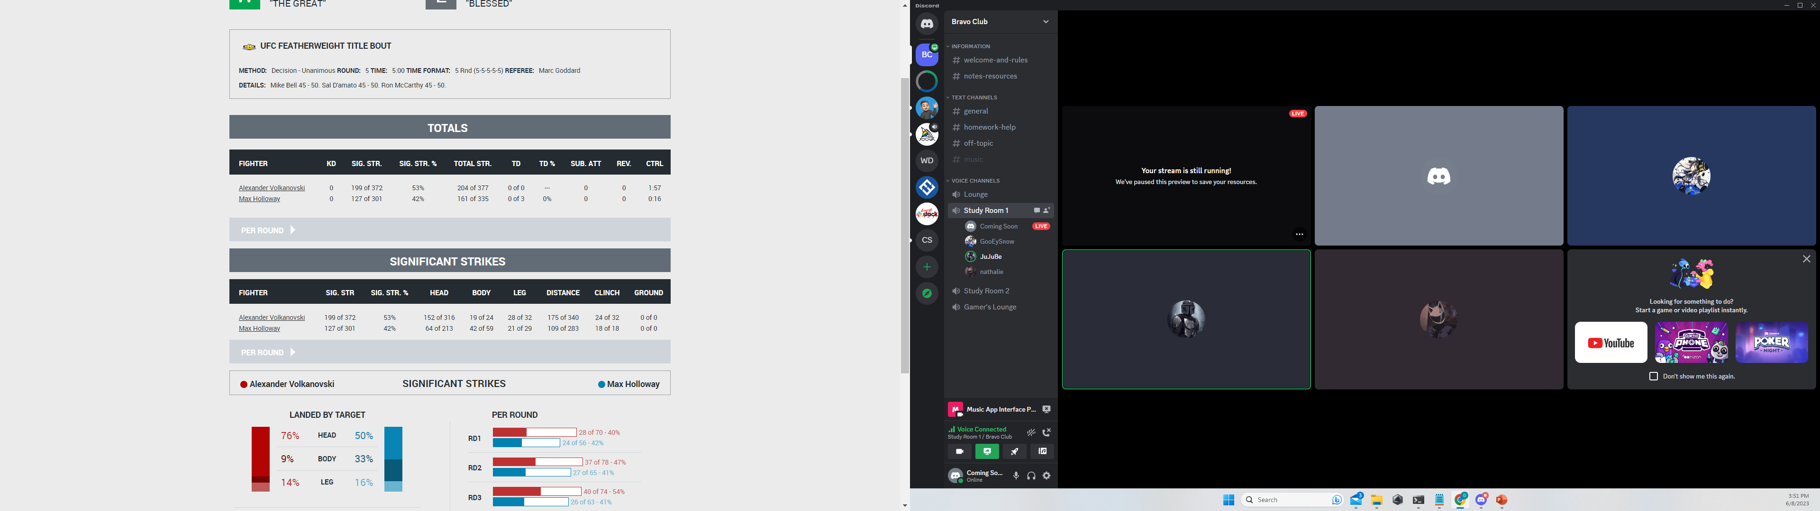
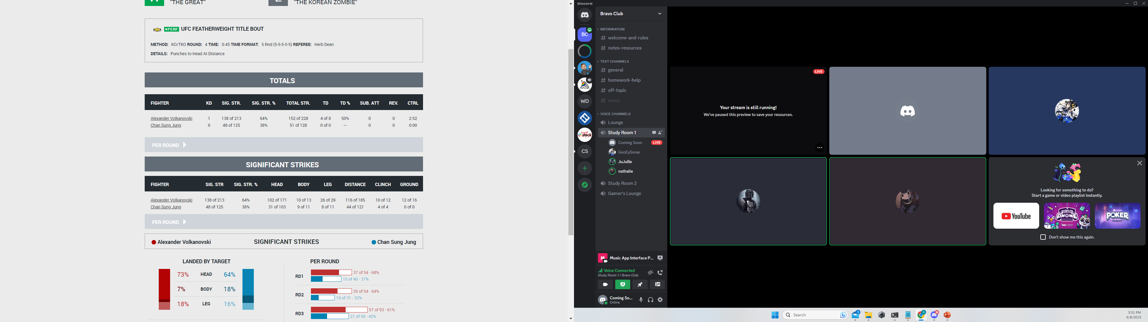

Predict Fight
Go to streamlit
Prediction accuracy up to 87 %

Slide 27

Thank You !

